Slide 1
WasteNot : A Culinary Resource Management and Distribution Network
SUDHIR S (210701269)
YAR ZAR MIN (210701318)
TAMILSELVAN A P (210701283)

Slide 2
PROBLEM STATEMENT
Despite the presence of surplus food resources in various sectors of society, including agriculture, retail, and hospitality, significant amounts of food still go to waste while many communities suffer from food insecurity. There is a lack of efficient mechanisms to connect surplus food producers with those in need within local communities, resulting in unnecessary waste and unmet food needs. This project addresses this problem by developing an application that streamlines the process of redistributing surplus food resources to deficient areas, promoting sustainable food practices and alleviating food insecurity within communities

Slide 3
ABSTRACT
The project creates an website that connects local scrap and food shortages and encourages donations and signatures. Users collect spare parts matched by the smart system or send the products they want. Communication tools encourage collaboration, while volunteer opportunities increase community engagement. Reports and impact analysis to ensure efficiency. Strong privacy measures protect user data. The app aims to eliminate food waste and food insecurity and improve community leadership by encouraging collaboration and raising awareness.

Slide 4
LITERATURE SURVEY
S.N0 | Year | Title | Author | Journal | Description
1 | 2022 | The future of surplus food redistribution in the UK: Reimagining a ‘win-win’ scenario | Ellisa Facchini | Papargyropoulou, E., Fearnyough, K., Spring, C. and Antal, L., 2022. The future of surplus food redistribution in the UK: Reimagining a ‘win-win’scenario. Food Policy, 108, p.102230. | This paper deals with the topical issue of the increasing amount of food waste generated as a direct consequence of excessive production, mismanagement, and wasteful behavior, representing a real challenge in achieving sustainability and resource efficiency.
2 | 2021 | Quantifying environmental implications of surplus food redistribution to reduce food waste | Mattia Damiani | Damiani, M., Pastorello, T., Carlesso, A., Tesser, S. and Semenzin, E., 2021. Quantifying environmental implications of surplus food redistribution to reduce food waste. Journal of cleaner production, 289, p.125813. | Ensuring access to food for the most vulnerable is one of the objectives of the UN 2030 Agenda for Sustainable Development. Rethinking food production and distribution systems in light of this need makes it imperative to limit the environmental burden of food supply chains to meet the increasing demand of a rapidly growing world population
3 | 2020 | "AI-based Optimization in Food Supply Chains" | Choi, T.-M., & Lambert, J. H. | Artificial Intelligence for Demand Prediction and Optimization | This research focuses on the application of AI for optimizing food supply chains. It covers predictive analytics for demand forecasting and AI-driven algorithms for routing optimization, ensuring efficient food distribution.

Slide 5
LITERATURE SURVEY
S.N0 | Year | Title | Author | Journal | Description
4 | 2022 | The social innovation for food waste reduction | Anna R Davies | Davies, A.R. and McGeever, A., 2022. Social innovation for food waste reduction: Surplus food redistribution. In Food Loss and Waste Policy (pp. 209-223). Routledge | This Social innovation around surplus food is also a vibrant arena of action, with grassroots responses to reducing food waste being both well established and emerging, particularly at the urban scale.
5 | 2020 | Surplus Food Redistribution | Jane Midgley | Midgley, J., 2020. Surplus food redistribution. In Routledge Handbook of Food Waste (pp. 349-362). Routledge. | This notes how discussions are often dominated by ideas of economic value, but when it is recognised that a good’s intended use may still be possible this also allows for social, cultural and political values to inform ideas and understandings of surplus food.
6 | 2021 | Reducing Food Waste with Predictive Analytics" | Xu, X., & Li, Y. | Antal, L., 2021. The future of surplus food redistribution in the UK: Reimagining a ‘win-win’scenario. Food Policy, 108, p.102230. | The paper explores how AI can be used to predict areas of food surplus and deficit, allowing for better planning and distribution of resources to minimize waste and address hunger.

Slide 6
LITERATURE SURVEY
S.N0 | Year | Title | Author | Journal | Description
7 | 2020 | Digital platforms: mapping the territory of new technologies to fight food waste | Massimo Cane | Cane, M. and Parra, C., 2020. Digital platforms: mapping the territory of new technologies to fight food waste. British Food Journal, 122(5), pp.1647-1669. | The reduction of food waste is still a pending issue that governments have still not resolved. In response to this problem mobile platforms are emerging that follow food ecology
8 | 2023 | Surplus food redistribution and rebound effect | Giulia Gallo | Berri, A. and Toma, L., 2023. Factors influencing consumer use of social supermarkets in the UK: A redistribution model providing low-cost surplus food. Cleaner and Responsible Consumption, 10, p.100133. | This study, the aim was to analyze consumers’ behavior after the purchase or collection of food that otherwise would have been wasted
9 | 2019 | "ERP Systems in Non-Profit Organizations: A Framework for Cooked Food Supply Chains" | Jones M | Jones, M., & Smith, A. (2019). "ERP Systems in Non-Profit Organizations: A Framework for Cooked Food Supply Chains" | This paper presents a framework for implementing ERP systems in non-profit organizations, specifically for managing cooked food supply chains. It covers modules for inventory management, logistics, and compliance

Slide 7
LITERATURE SURVEY
S.N0 | Year | Title | Author | Journal | Description
10 | 2019 | Community-based Platforms for Food Security: Case Studies and Best Practices | Johnson P , Walker D | Community-based Platforms for Food Security: Case Studies and Best Practices(pp. 349-362). Routledge. | The research provides case studies of successful community-based platforms that facilitate food donations and distribution. It highlights best practices for engaging community members and creating sustainable food networks.
11 | 2022 | Increasing surplus food redistribution to improve food access through a partnership between public health and a technology-based company | Victoria Ayala, Julia I Caldwell, Bernadet Garcia-Silva | Journal of Health Care for the Poor and Underserved 33 (5), 7-24, 2022 | This study describes a public-private partnership that scaled such an effort in Los Angeles County.
12 | 2021 | Participating in food waste transitions: exploring surplus food redistribution in Singapore | Monika Rut, Anna R Davies | Journal of Environmental Policy & Planning 23 (1), 34-47, 2021 | This paper examines whether the ecologies of participation (EOP) approach provides a conceptual framing for understanding the role of publics within food waste transitions in Singapore

Slide 8
LITERATURE SURVEY
S.N0 | Year | Title | Author | Journal | Description
13 | 2021 | Surplus food redistribution and healthy, sustainable diets: Exploring the contradictions of charitable food provisioning | Tara Kenny | Research Committee on Sociology of Agriculture and Food (RC-40) of the International Sociological Association (ISA), 2021 | This transition is the need to reduce food waste and food loss by 50 percent and where charitable surplus food redistribution is regarded as making an important contribution to this target.
14 | 2020 | Sustainability assessment of food redistribution initiatives in Sweden | Pauline Bergström, Christopher Malefors | Bergström, P., Malefors, C., Strid, I., Hanssen, O.J. and Eriksson, M., 2020. Sustainability assessment of food redistribution initiatives in Sweden. Resources, 9(3), p.27. | The aim of this study was to identify and study surplus food redistribution units in Sweden, and then to assess the impact on several sustainability indicators for selected redistribution units
15 | 2020 | Mobile Application and Community Platform | Smith J | Smith, J., & Thompson, R. (2020). "Connecting Communities: Mobile Applications for Food Waste Reduction | This study examines mobile applications designed to connect food donors with recipients. It discusses the features of such apps, including real-time notifications, community engagement, and incentive programs for donors and volunteers.

Slide 9
LITERATURE SURVEY
S.N0 | Year | Title | Author | Journal | Description
16 | 2022 | How COVID-19 impacted surplus food redistribution in the Netherlands: An explorative study | Madhura Rao | Rao, M., Bast, A. and de Boer, A., 2022. How COVID-19 impacted surplus food redistribution in the Netherlands: An explorative study. Food Security, 14(6), pp.1377-1385 | This paper investigates how the pandemic impacted surplus food redistribution in the country by employing an Exploratory-Descriptive-Qualitative approach.
17 | 2019 | Surplus Food Redistribution | Paul Johnson | Johnson, P., & Walker, D. (2019). "Community-based Platforms for Food Security: Case Studies and Best Practices" | The research provides case studies of successful community-based platforms that facilitate food donations and distribution. It highlights best practices for engaging community members and creating sustainable food networks.
18 | 2021 | Surplus Food Redistribution: Towards a World Where No Good Food Goes to Waste | Andrea Veselá | Antal, L., 2021. The future of surplus food redistribution in the UK: Reimagining a ‘win-win’scenario. Food Policy, 108, p.102230. | The paper explores how AI can be used to predict areas of food surplus and deficit, allowing for better planning and distribution of resources to minimize waste and address hunger.

Slide 10
LITERATURE SURVEY
S.N0 | Year | Title | Author | Journal | Description
19 | 2022 | An Evaluation of the Alignment of Surplus Food Recovery and Redistribution Technologies | Sana Abusin, Noor Al-Emadi | Abusin, S., Al-Emadi, N. and Mandikiana, B., 2023. An Evaluation of the Alignment of Surplus Food Recovery and Redistribution Technologies with the Circular Economy. Sustainability, 15(16), p.12355. | Our study aims to provide basic information for innovative mobile application development that addressed food insecurity and waste in Qatar
20 | 2020 | Surplus Food Redistribution | Jane Midgley | Midgley, J., 2020. Surplus food redistribution. In Routledge Handbook of Food Waste (pp. 349-362). Routledge. | This notes how discussions are often dominated by ideas of economic value, but when it is recognised that a good’s intended use may still be possible this also allows for social, cultural and political values to inform ideas and understandings of surplus food.

Slide 11
PROPOSED SYSTEM
The proposed system for the project aims to create an innovative and impactful platform dedicated to reducing food waste and aiding communities in need. By connecting restaurants, caterers, households, and NGOs, the system facilitates the efficient redistribution of surplus food to those who require it most. The platform will include user-friendly interfaces for each participant category, enabling easy registration, login, and profile management. Restaurants and caterers can list their available surplus food, while NGOs can efficiently coordinate pickups and distribution. The system leverages modern web technologies, including responsive design via Bootstrap, dynamic content handling with JavaScript, and robust backend support through Firebase. This ensures real-time updates and seamless communication between all parties involved. Additionally, motivational content and calls to action throughout the site aim to inspire and engage users, encouraging widespread participation and fostering a community-driven effort to combat food insecurity and promote sustainability.

Slide 12
METHODOLOGY
The methodology for project involves a structured approach beginning with thorough requirement analysis to define the necessary functionalities. The system design phase includes creating a high-level architecture, structuring the database, and developing intuitive UI/UX designs. Development involves building a responsive frontend with HTML, CSS, and JavaScript, while integrating Firebase for backend services such as authentication and real-time database operations. Rigorous testing, including unit, integration, and user acceptance testing, ensures the system's reliability. Deployment is executed in stages, starting with a staging environment for final validation before launching in production. Post-deployment, the system is monitored for performance, with continuous maintenance and support provided to address bugs and updates to provide continuous improvement of the platform, ensuring it effectively combats food waste and supports community welfare.

Slide 13
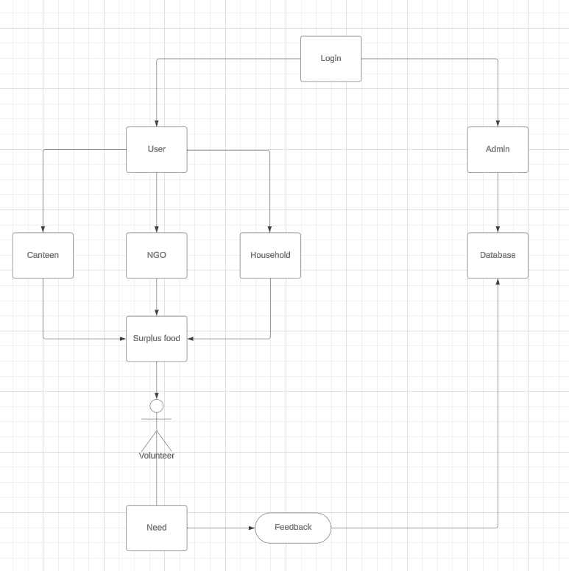
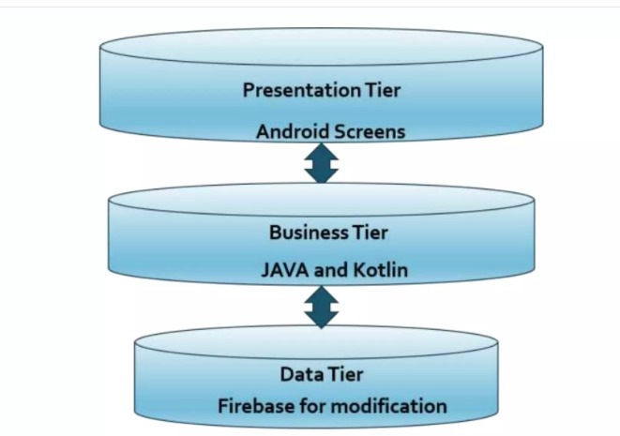
SYSTEM ARCHITECTURE

Slide 14
MODULES
User Management:Authentication and Authorization: Handles user registration, login, and role-based access control (NGOs, restaurants, caterers, households). Profile Management: Allows users to view and edit their profiles
Food Listing and Management :Food Donation: Enables restaurants and caterers to list surplus food items, including details like type, quantity, and availability. Food Requests: Allows NGOs to browse and request available food donations..

Slide 15
MODULES
Administrative Panel: User and Content Management: Allows administrators to manage users, monitor activities, and oversee the content on the platform. Analytics and Reporting: Provides tools for tracking usage statistics and generating reports on food donations and distributions.
User Interface: Responsive Design: Ensures that the web application is accessible and functional across various devices and screen sizes using Bootstrap. Dynamic Content: Displays personalized content based on user roles and session

Slide 16
MODULES
Real-Time Database Integration: Data Storage: Uses Firebase to store and retrieve user data, food listings, and transaction history. Updates and Notifications: Provides real-time updates and notifications to users about new listings and status changes.
Communication Interface: Messaging System: Facilitates communication between food donors (restaurants/caterers) and recipients (NGOs).Notification System: Sends alerts and reminders to users regarding food availability and requests. .

Slide 17
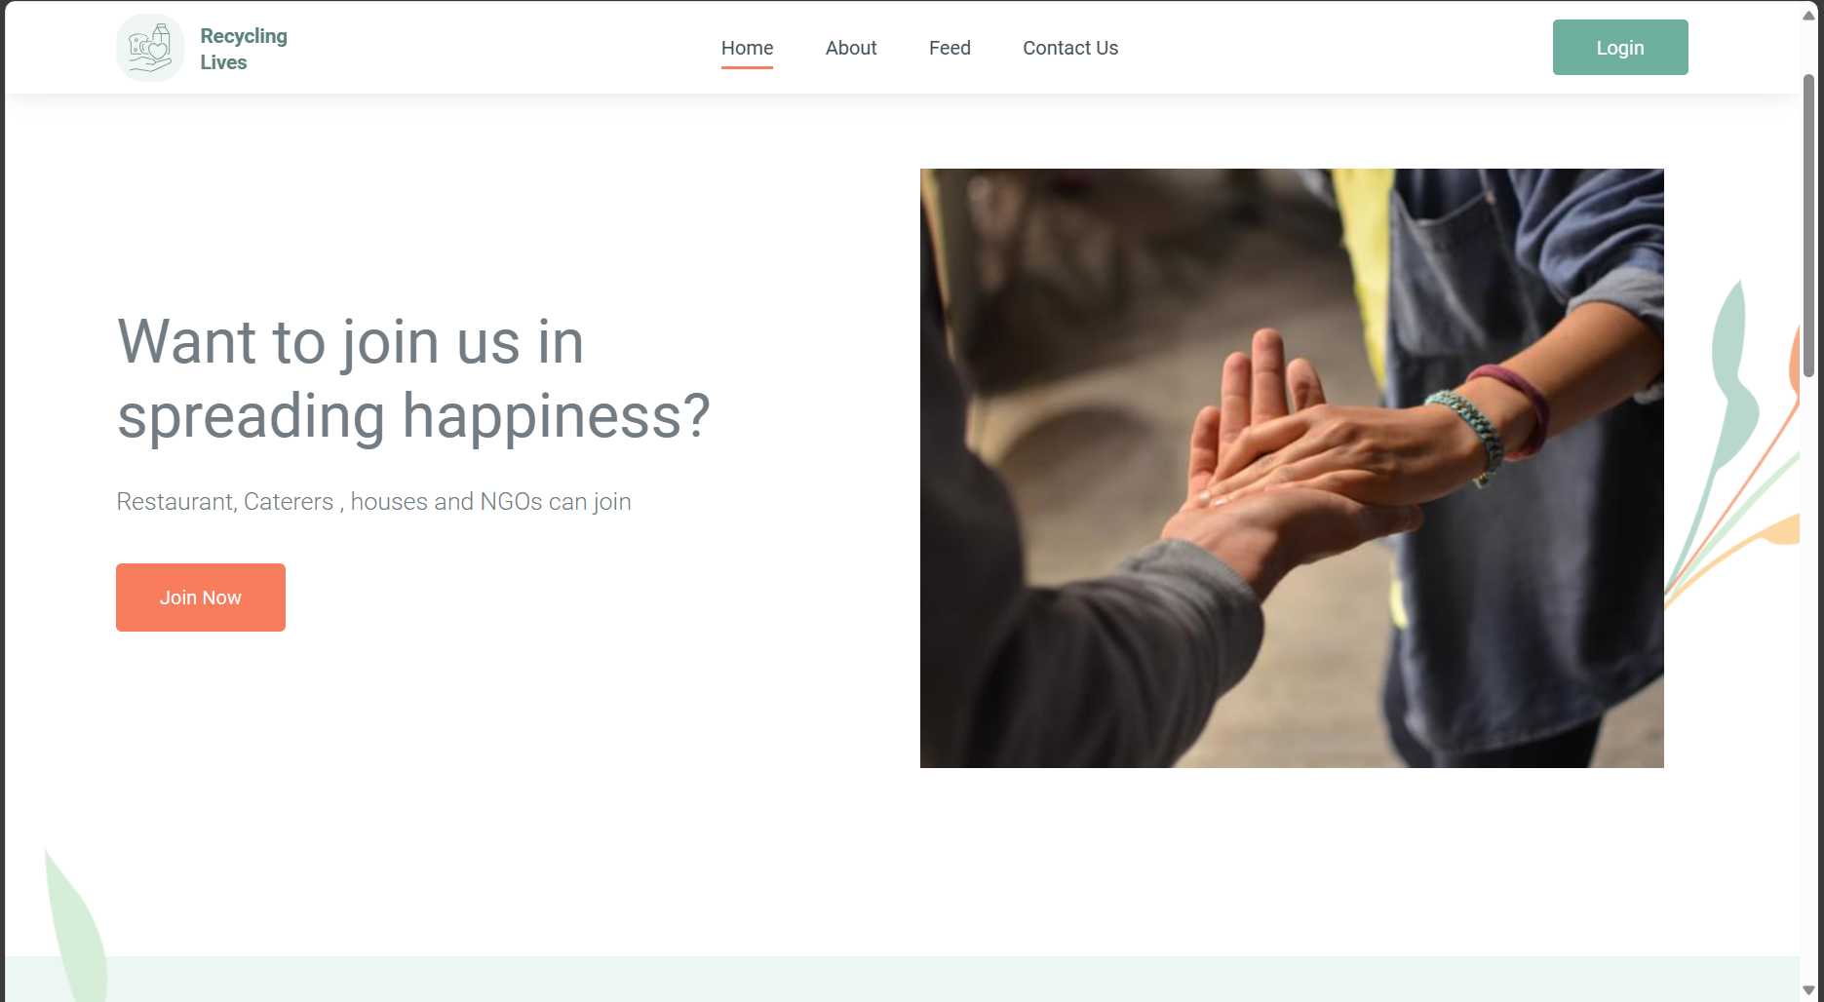
OUTPUT SCREENSHOTS

Slide 18
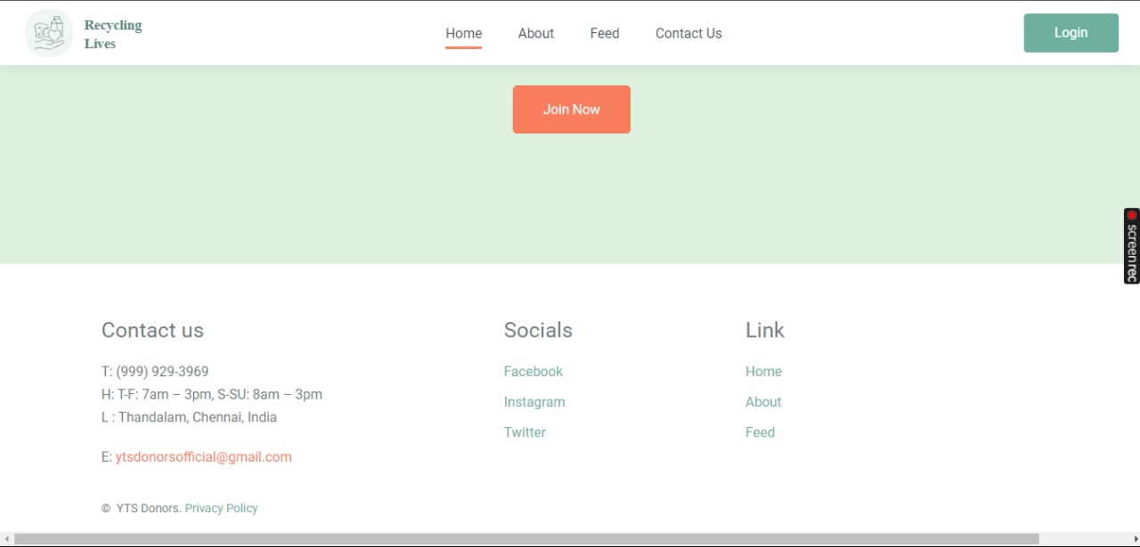
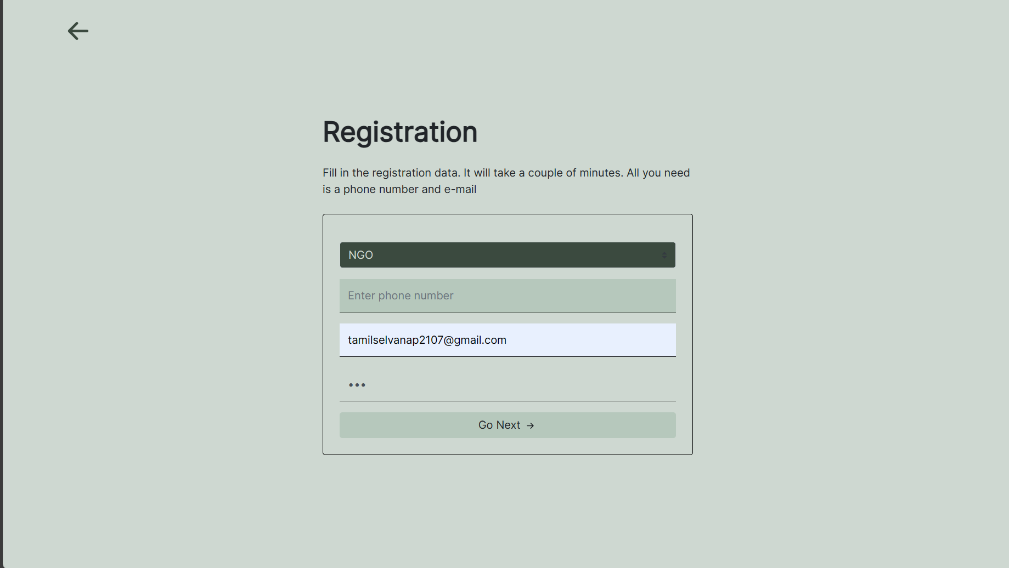
OUTPUT SCREENSHOTS

Slide 19
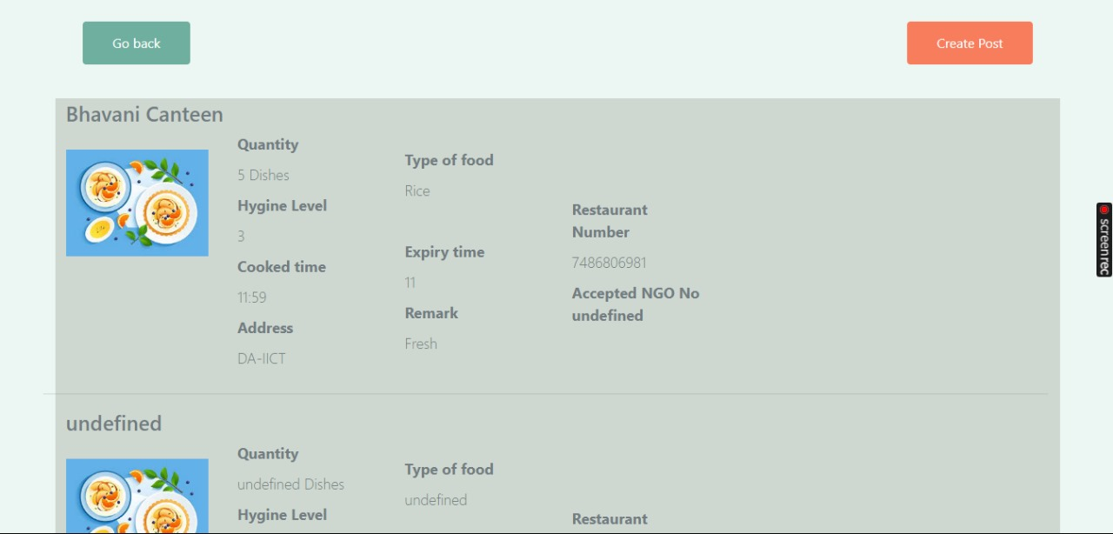
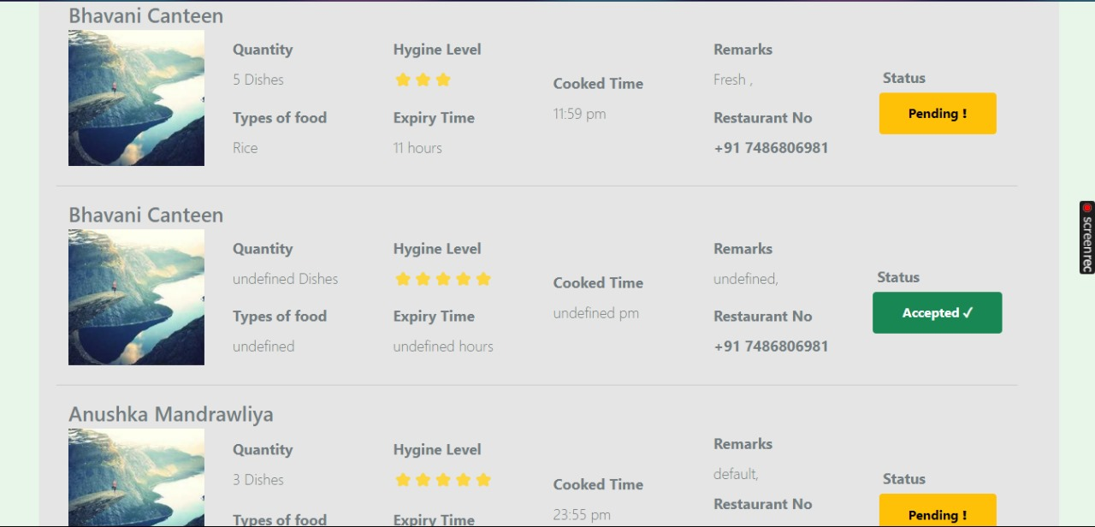
OUTPUT SCREENSHOTS

Slide 20
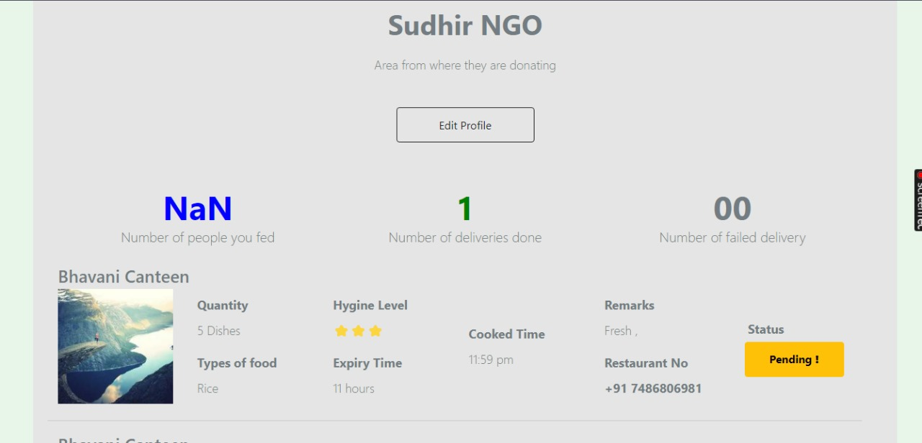
OUTPUT SCREENSHOTS

Slide 21
CONCLUSION
In conclusion, the project aims to create a transformative platform that effectively addresses the critical issue of food waste while supporting community welfare. By leveraging modern web technologies, including responsive design, real-time database integration, and dynamic user interfaces, the system ensures seamless interaction between restaurants, caterers, NGOs, and households. The comprehensive methodology, from requirement analysis to continuous improvement, guarantees that the platform is both user-friendly and robust. With its focus on facilitating efficient food redistribution, fostering community engagement, and promoting sustainability, "Recycling Lives" not only helps in reducing food waste but also plays a significant role in enhancing the lives of those in need, thereby making a substantial impact on society.

Slide 22
FUTURE ENHANCEMENTS
Looking ahead this project could include developing a mobile application for greater accessibility, implementing AI-driven matching algorithms to optimize food redistribution, and introducing new user roles such as volunteers and drivers. Enhanced analytics dashboards, gamification elements, and integration with local services could further improve user engagement and operational efficiency. Additional features like multilingual support, sustainability metrics, community forums, blockchain for transparency, and automated inventory management would broaden the platform's capabilities. Partnerships with delivery services and organizing virtual and physical events could also enhance community involvement and awareness. These enhancements aim to expand the platform's reach and effectiveness, making it a more powerful tool in combating food waste and hunger.

Slide 23
THANK YOU !

